Slide 1
Data Warehousing
An Introduction to
Theory, Architecture, and Applications

Slide 2
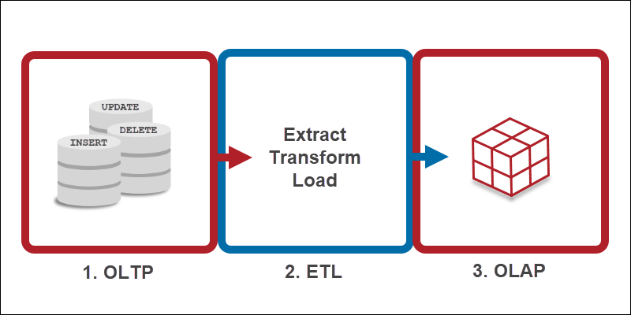
Background
OLTP = Online Transaction Processing
Optimized for transactional processing and real-time updates
Used to manage day-to-day business operations involving individual transactions
Used for real-time processing of online transactions at scale, such as reservation systems and online sales
Designed to quickly process tons of small-scale transactions in real time
OLAP = Online Analytical Processing
Optimized for complex data analysis and reporting
Used by data scientists, business analysts, and knowledge workers to analyze large data sets from multiple perspectives
Systems support business intelligence (BI), data mining, and other decision support applications
Designed to handle complex queries for rapid analysis
Notes:
Also a third data processing option (HTAP) will touch on later

Slide 3
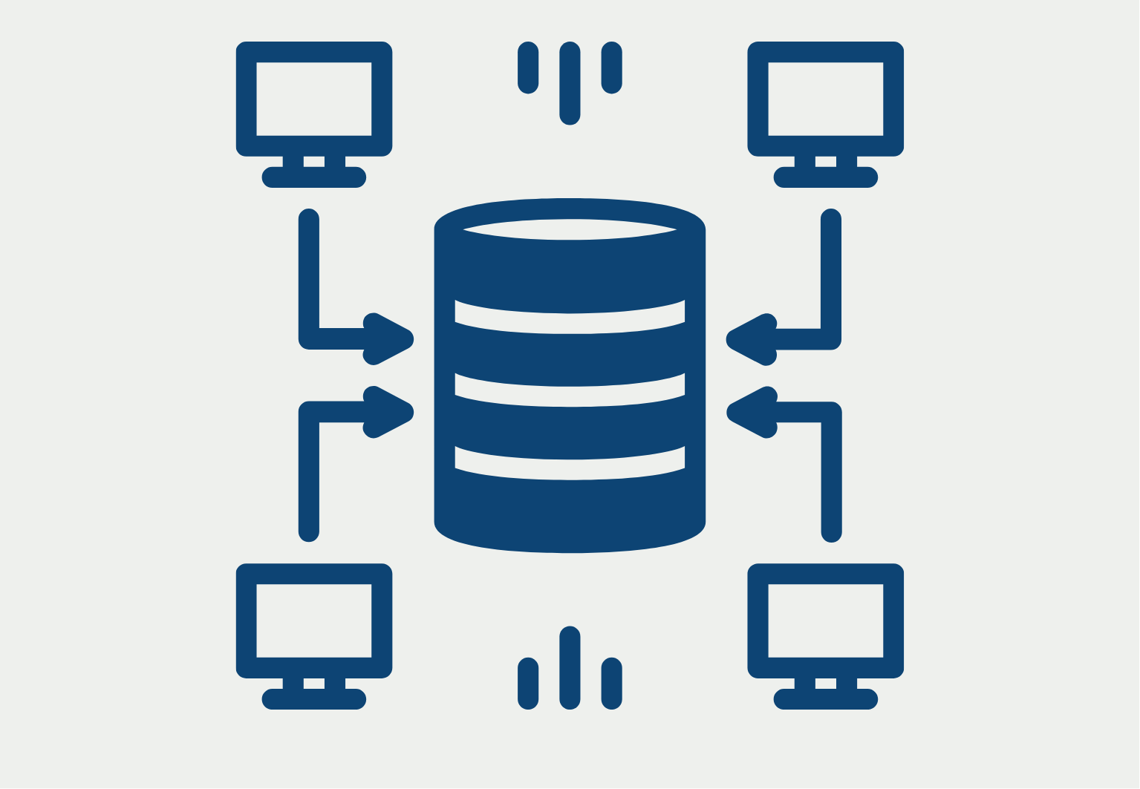
What is a data warehouse?
A data warehouse is a centralized system that stores and organizes large amounts of data from multiple sources for reporting and analysis. It can store both current and historical data and can provide a long-range view of change data over time. Data is usually cleaned and standardized before it's stored in a data warehouse.

Slide 4
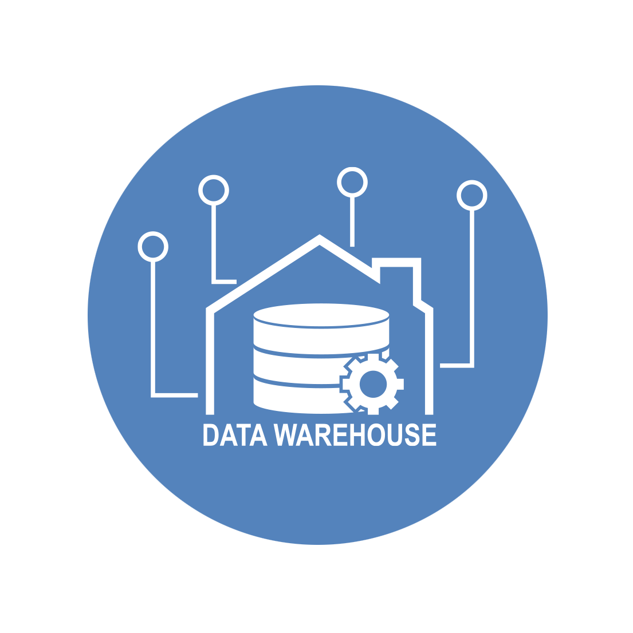
Data Warehouse Characteristics
Subject-Oriented: A data warehouse uses a theme and delivers information about a specific subject instead of a company’s current operations. In other words, the data warehousing process is more equipped to handle a specific theme. Examples of themes or subjects include sales, distributions, marketing, etc.
Integrated: Integration is defined as establishing a connection between large amount of data from multiple databases or sources. However, it is also essential for the data to be stored in the data warehouse in a unified manner. The process of data warehousing integrates data from multiple sources, such as a mainframe, relational databases, flat files, etc. Furthermore, it helps maintain consistent codes, attribute measures, naming conventions, and formats.
Time-variant: Time-variant in a data warehouse is more extensive as compared to other operating systems. Data stored in a data warehouse is recalled with a specific time period and provides information from a historical perspective.
Non-volatile: In the non-volatile data warehouse, data is permanent e.g. when new data is inserted, previous data is not replaced, omitted, or deleted. In a data warehouse, data is read-only and only refreshes at certain intervals. The two data operations performed in the data warehouse are data access and data loading.

Slide 5
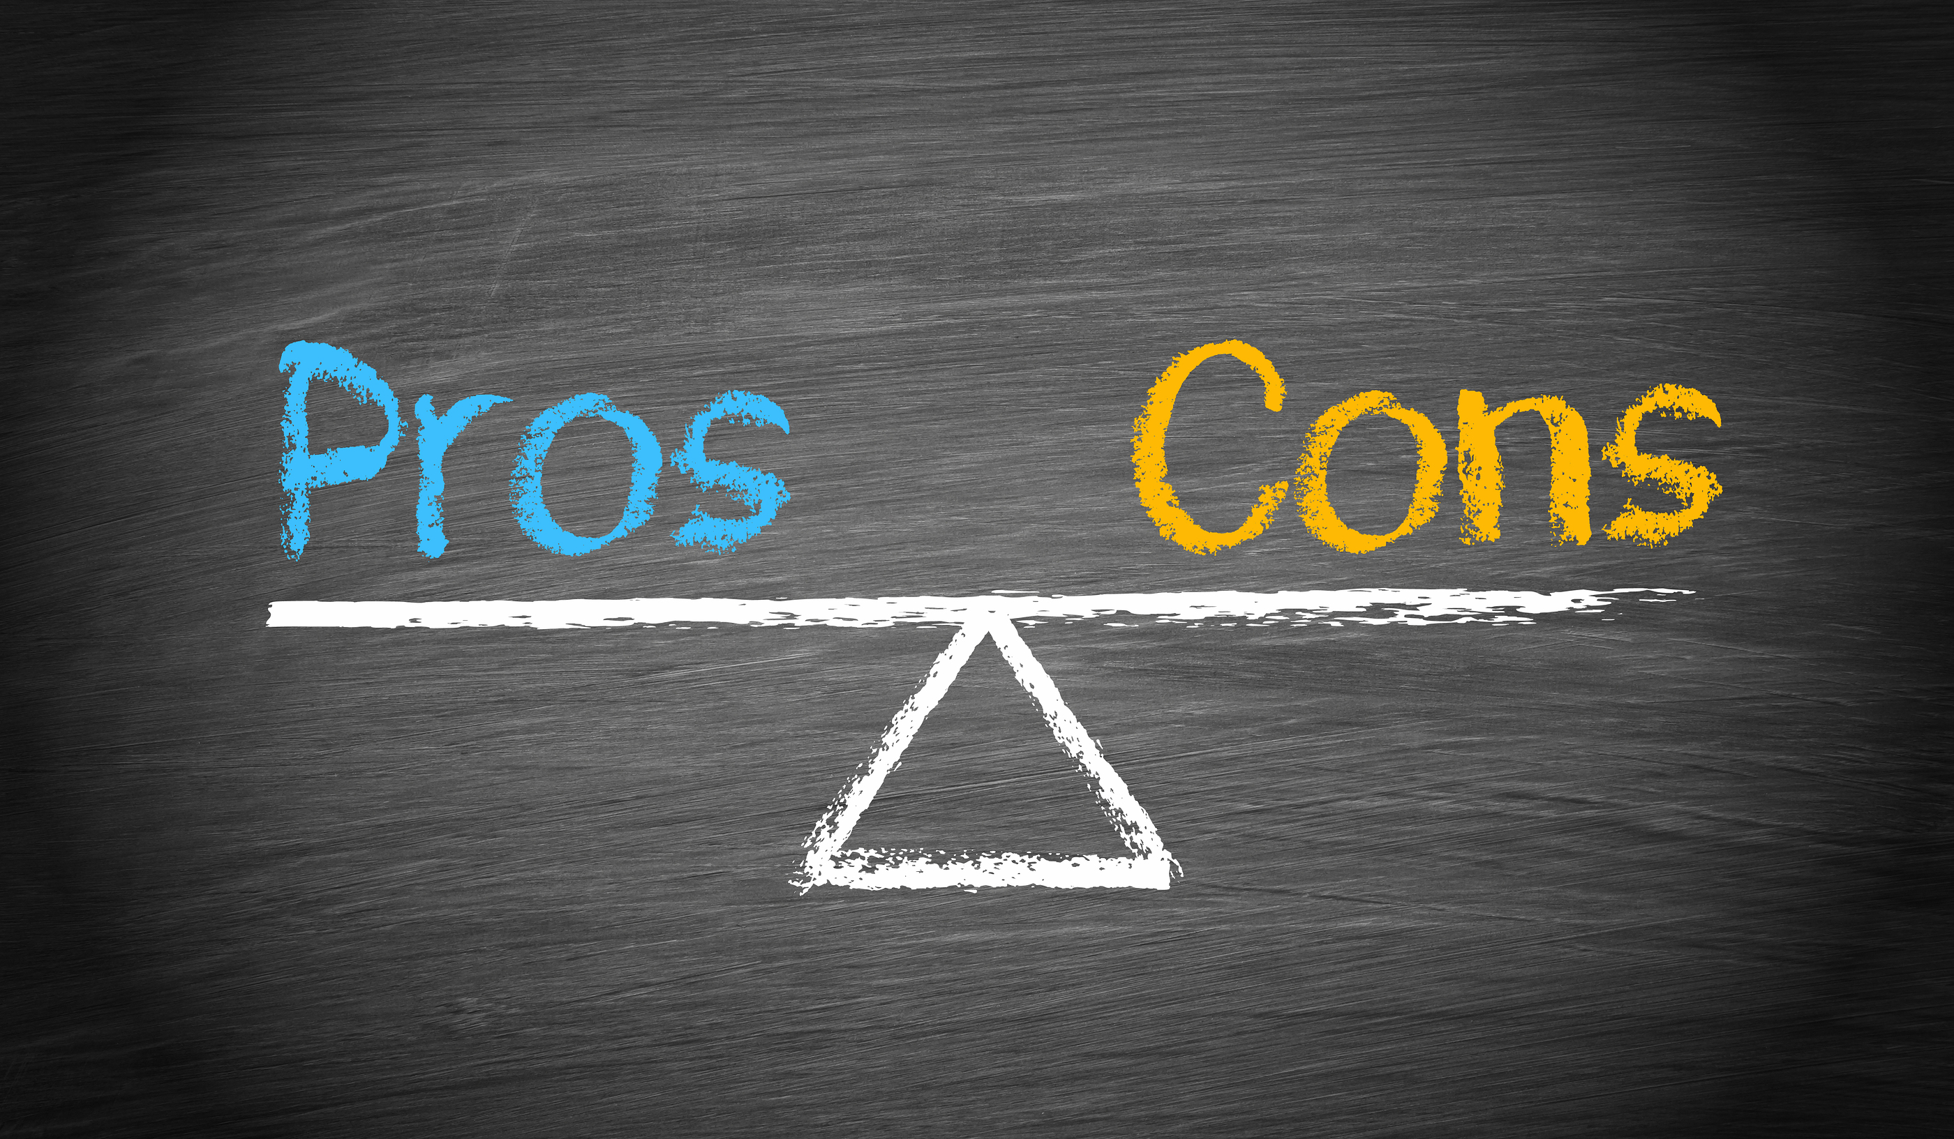
Data Warehouse Pros and Cons
Pros
Improve data accessibility for a wider range of users
Provide greater scalability for growing datasets
Increase performance/speed
Improve data quality management
Improve business intelligence and efficiency
Save time and enhance decision-making speed
Maintain historical data for long-term insight and forecasting
Increase data security
Cons
Can demand significant resources for implementation and maintenance
Can require extra effort for reporting
Can be inflexible for unstructured data
Can lead to ownership concerns in large organizations (data governance)

Slide 6
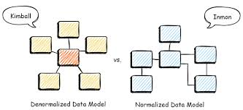
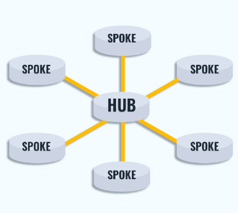
Data Modeling Approaches
Kimball
Bottom-up approach (data marts first) that focuses on business processes and needs
Uses star schemas
Quick development of useful data structures is the highest priority
Good for quick development, ease of use, and tailored data for specific business units
May have limitations in scalability, flexibility, and historical data management
Inmon
Top-down approach (EDW first) that emphasizes data and is good for organizations that need a single source of truth for complex reporting
Uses 3NF schema
Data consistency is the highest priority
Can be complex to add multiple tables to the data model
Requires skilled resources that can be expensive and hard to find
Data Vault
Hybrid approach that combines elements of both Kimball and Inmon
Uses hub-and-spoke schema
Hub: entity of interest
Spoke/satellite: historical metadata
Link: connect hubs through a defined relationship
Speed of both development and run time is the highest priority
Focuses on the relationships between data and is good for organizations that need scalability, agility, and raw data storage
Designed to handle changes and additions to the data model with minimal impact on existing structures
Notes:
As proposed by Ralph Kimball, the bottom-up method calls for the creation of many data marts to satisfy the analytical needs of departments, followed by virtual integration of these data marts for consistency through an information bus.
In the perspective of Bill Inmon, the first step should be to create a consolidated enterprise-wide data warehouse. This can be made by connecting numerous databases to the analytical needs of departments, which are later referred to as data marts. As a result, this method is known as the top-down approach.
Hubs: hubs are entities of interest to the business. They contain just a distinct list of business keys and metadata about when each key was first loaded and from where.
Links: links connect Hubs and may record a transaction, composition, or other type of relationship between hubs.
Satellites: satellites connect to hubs or links and store metadata about when the data were loaded and from where. They great for versioning and doing historical analysis.
Use Inmon if…
Data accuracy is the most important characteristic of your warehouse
You have time/resources to do a lot of upfront work
Use Kimball if…
If you business requirements are well-defined and stable
You are querying lots of data often
Use a Data Vault if…
Your business goals change often
You need version-control inherently built into your infrastructure
Difference between star schema and data vault:
Data vault architecture
Data vault uses a modular approach to data warehousing. It's designed to be flexible and scalable, and to integrate data from multiple sources. Data vault is meant to be complementary to star schema, acting as an intermediary between staging and reporting layers.
Star schema architecture
Star schema is a dimensional model that organizes data into a structure that improves analytical query performance. It's often used in the presentation layer, where refined data is ready for business intelligence.

Slide 7
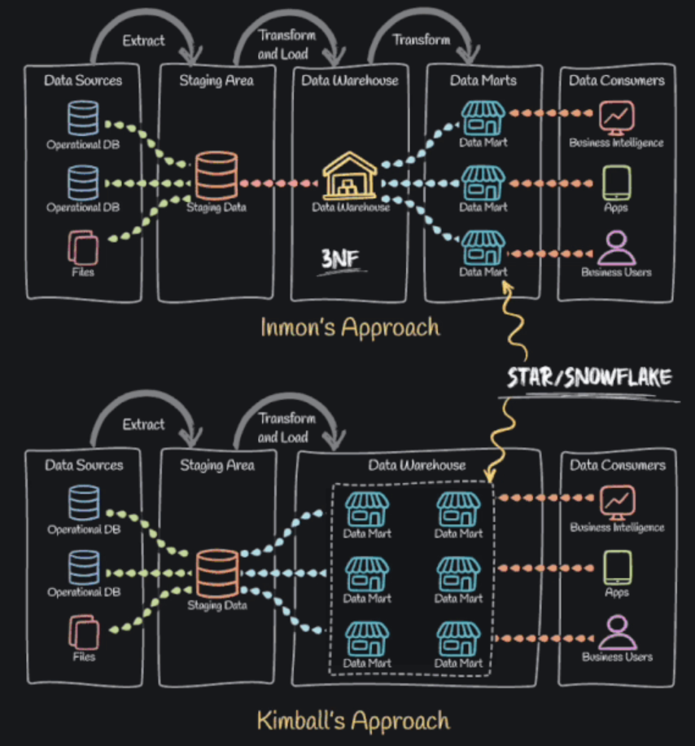
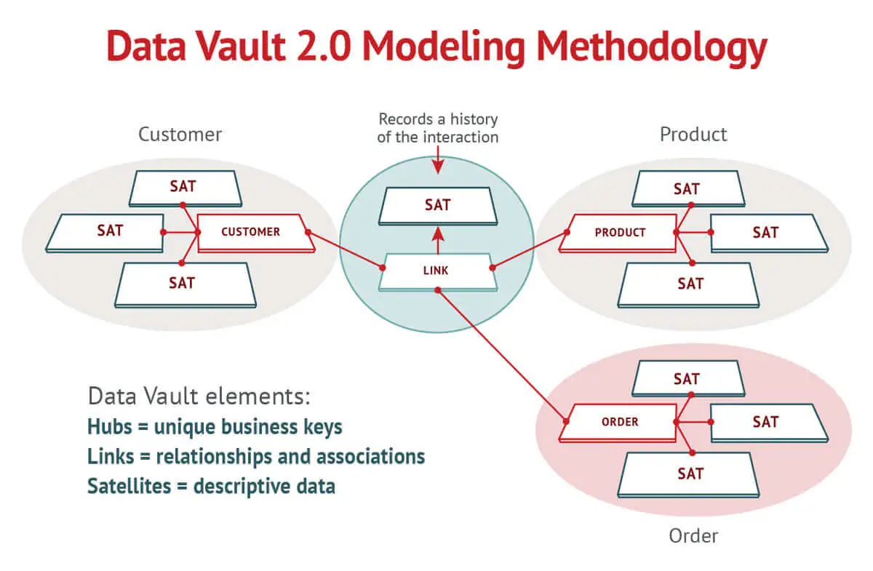
Which one?
Use Inmon if…
Data accuracy is the most important characteristic of your warehouse
You have time/resources to do a lot of upfront work
Use Data Vault if…
Your business goals change often
You need version-control inherently built into your infrastructure
Use Kimball if…
Your business requirements are well-defined and stable
You are querying lots of data often

Slide 8
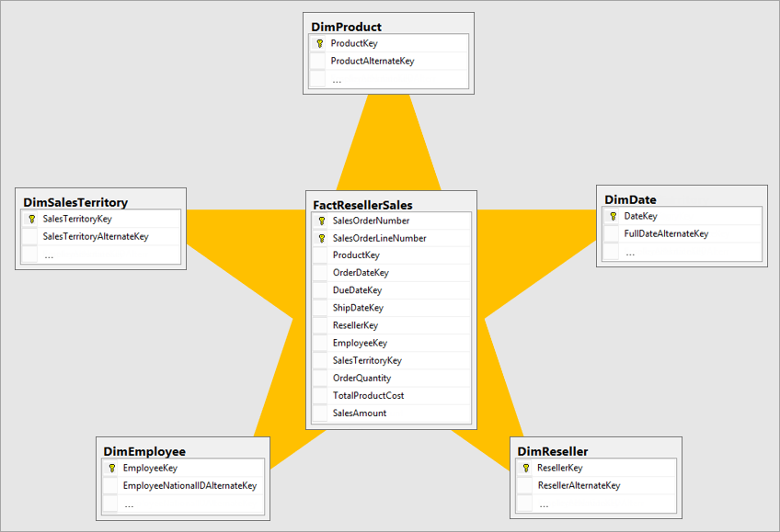
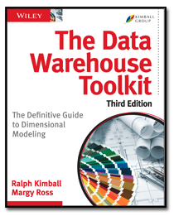
The Kimball Methodology: Star Schemas
A star schema is most widely used to develop data warehouses and dimensional data marts. It consists of one or more fact tables referencing any number of dimension tables.
A fact table is a table for measurements, quantities, or transactions. It holds information that can be aggregated.
(When? How much?)
Dimension tables hold information and attributes about a business object.
(Who? What? Where?)
Dimension tables support filtering and grouping
Fact tables support summarization
For more information on the Kimball methodology see:
The Data Warehouse Toolkit

Slide 9
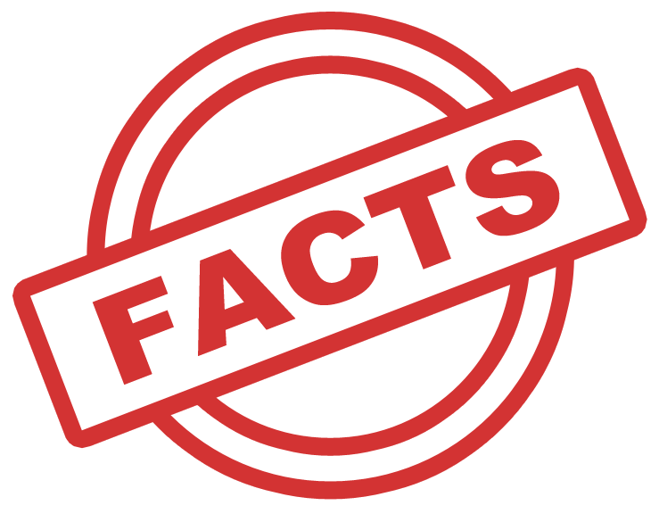
The Kimball Methodology: Facts
The 3 most common types of fact tables are:
Transactional
The most basic type of fact table, which records individual events such as sales transactions or website clicks.
Periodic Snapshot
Captures the status of a process at regular intervals, such as daily or monthly sales totals. For example, a daily snapshot of inventory levels for each product in a warehouse.
Accumulating Snapshot
Shows the progression of a process over time, such as the stages of an order fulfillment process. For example, an order processing accumulating snapshot records are revisited and overwritten as the process progresses.

Slide 10
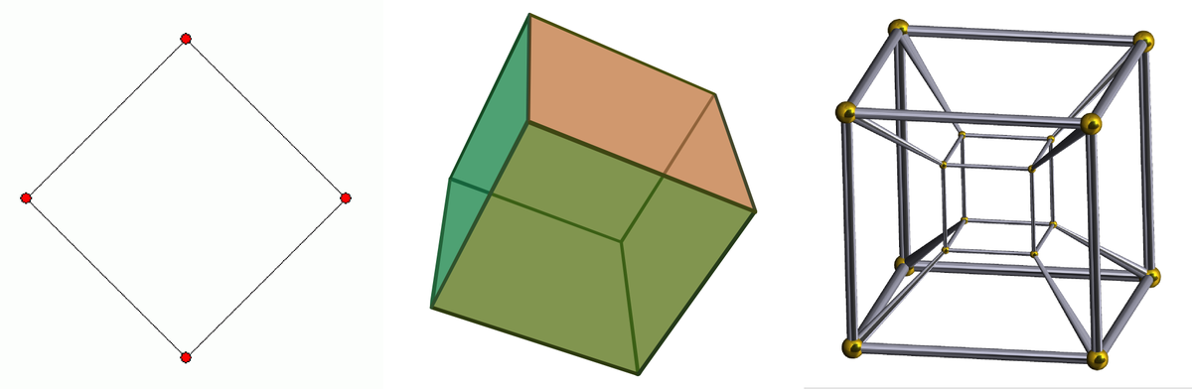
The Kimball Methodology: Dimensions (dims)
Some of the most common types of dimension tables are:
Calendar Date Dimension (dim date)
A special type of dimension that can be used to represent dates with a granularity of a day. The date dimension can include other attributes like the week of the year, or flags representing work days, holidays, etc. It could also include special rows representing not known dates, or yet to be defined dates. The date dimension should be initialized with all the required dates, say the next 10 years of dates, or more if required, or past dates if events in the past are handled.
Junk Dimension
A junk dimension is a cartesian product of every possible combination of values for a set of attributes. It usually consists of attributes that do not belong in the fact table or in any of the existing dimension tables.
Slowly Changing Dimension (SCD)
A slowly changing dimension is a set of data attributes that change slowly over a period of time rather than changing regularly e.g. address or name. These attributes can change over a period of time and that will get combined as a slowly changing dimension.
The 3 most common types of SCDs are:
Type 0 (Retain original)
No history is saved. Data remains static
Type 1 (Overwrite)
Old values are overwritten with new values. No historical data is saved.
Type 2 (Add new row)
A new row is created with either a start date / end date or a version for a new value. This creates history.

Slide 11
Data Warehouse vs Data Mart
Data Warehouse
Data Mart
Focus
Data sources
Data volume
Data structure
Ownership
Data analysis
Cost
Central repository for shared data across an organization
Subset of a data warehouse that serves a specific business unit
Can contain data from hundreds of sources and applications
Sources data from a limited number of sources, such as a data warehouse or departmental databases
Typically contains at least 100GB of data and can have many terabytes
Usually much smaller than a data warehouse
Stores data in a structured format
Data integration process is more streamlined and targeted
Owned by the organization’s data management team
Owned by the relevant department
Designed for analytical work
Helps teams gain insights faster by providing a more focused approach to data integration
Can be more expensive, especially for large-scale analytics workloads
Cost depends on the scale and complexity of the underlying data warehouse

Slide 12
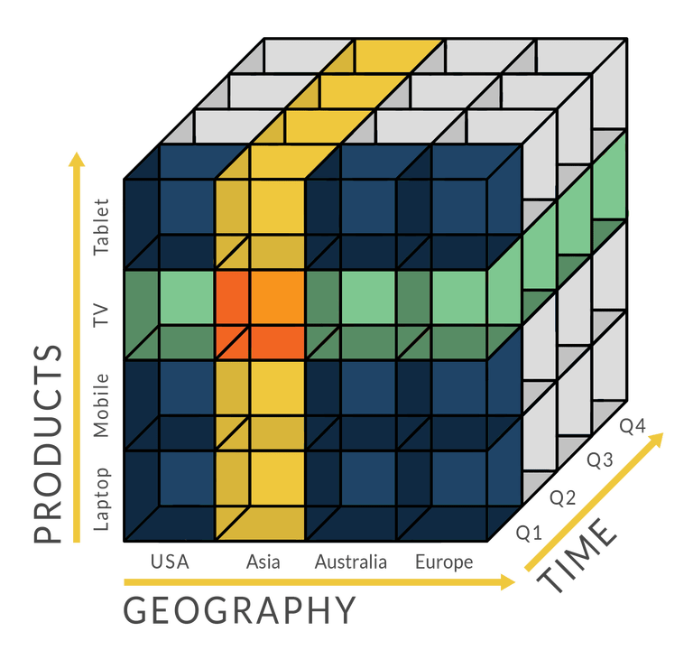
OLAP Cubes
An OLAP cube is a data structure that overcomes the limitations of relational databases by providing rapid analysis of data. Cubes can display and sum large amounts of data while also providing users with searchable access to various data points.
Advantages:
One of the main advantages of OLAP is that it allows you to perform complex and fast queries on large amounts of data. OLAP cubes use pre-computed summaries and aggregations to store data in a multidimensional format. This reduces the need for joining tables and scanning the entire database, which can improve query performance and response time. OLAP also enables you to drill down, slice, dice, and pivot the data to explore different aspects and levels of detail. This can help you discover patterns, trends, and insights that are not obvious from flat tables.
Disadvantages:
OLAP cubes require periodic updates and refreshes, which can consume a lot of resources and affect the availability and accuracy of the data. OLAP may not be suitable for real-time or transactional data, as it may not reflect the latest changes and events.

Slide 13
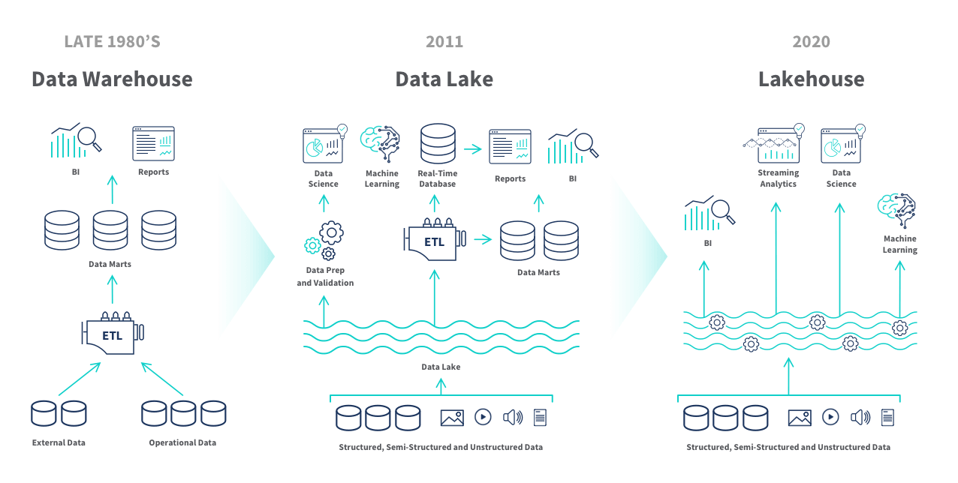
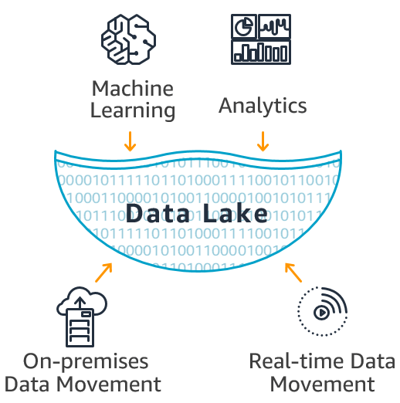
Data Warehouse vs Data Lake vs Data Lakehouse
Data warehouses store structured and semi-structured data that's been processed for a specific purpose. Data lakes store all types of data, including raw and unstructured data. Data warehouses define schemas before data sets are loaded, while data lakes define schemas after data sets are stored. It is possible to have a hybrid of the two, called a Data Lakehouse, by combining the key benefits of data lakes (large repositories of raw data in its original form) and data warehouses (organized sets of structured data)
2-tier option as well

Slide 14

Performance Optimization
Some tools for performance tuning:
Data Model Design
Indexing
Partitioning
Data Compression
Materialized Views
Query Tuning
Query Caching
Hardware Upgrades
Cluster Distribution
Query Workload Management
Query Parallelism
Query Cache Invalidation
More performance tips:
Optimize data and queries together for performance
Separate workloads with decoupled storage-compute
Minimize data access with sorting, partitioning, and indexing
Rewrite queries to use predicate ”push-downs”, substitutions, and cached results
Precompute aggregations as materialized views or indexes
Precompute joins as materialized views or indexes
Accelerate searches with indexing
Be JSON-aware for storage and queries
Evaluate query execution
Choose the best cluster for each workload
Ingest continuously

Slide 15

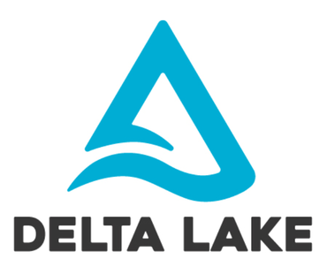
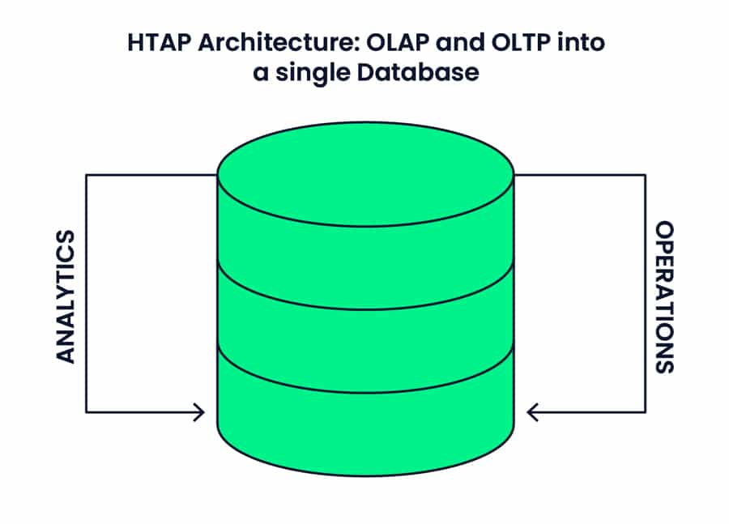
Emerging trends
Real-time data warehouse (RTDW) – Streaming data
The data in a real-time data warehouse is refreshed continuously, providing a much more accurate picture of the organization’s current state when the data is analyzed. They are designed to process data as soon as it's created, allowing organizations to make decisions based on the most up-to-date information.
Delta Lakes
A Delta Lake is an open-source storage layer that improves the reliability, security, and performance of data lakes. It's designed to run on top of an existing data lake and supports a variety of features, including
ACID transactions: Atomic, consistent, isolated, and durable transactions
Scalable metadata: Handles large amounts of data, including terabytes or petabytes
Unified streaming and batch data processing: Allows you to use a single copy of data for both batch and streaming operations
Schema enforcement: Prevents bad data from causing data corruption
Time travel: Allows you to access or revert to earlier versions of data
Audit history: Logs all change details to provide an audit trail
HTAP
Hybrid Transactional and Analytical Processing (HTAP) is a data architecture that combines online transactional processing (OLTP) and online analytical processing (OLAP) into a single system. HTAP allows for real-time analytics and business decision making by enabling processing on the same data store.
Notes:
Both Delta Lake and Data Lake offer distinctive advantages. Data Lake provides flexibility and storage for diverse data types, regardless of their size. This is ideal if you need to house a wide range of data for potential future use cases.
At the same time, Delta Lake offers transactional and schema enforcement capabilities. This is optimal choice if you require trust in the accuracy of data used for analytics. To determine which data management solution to rely on, you should evaluate your organization’s needs, processing, and scalability requirements.

Slide 16

Questions?

